Slide 1
WP6 – Dissemination and Exploitation
7 February 2019

Slide 2
AVAILABLE TOOLS
Platooning ENSEMBLE LinkedIn Community
ERTICO Innovation Twitter account (@ERTICO)
ENSEMBLE website/ETPC Platform
Dissemination & Communication Plan (D 6.1)
Visual identity and guidelines
Dissemination approval procedures

Slide 3
PROJECT COMMUNICATION CHANNELS
CHANNEL | TARGET
Project website | Industries, Users, Institutions, Research, Other road users
Blogs and social media | Industries, Users, Institutions, Research, Other road users
One-to-one conversations | Industries, Users, Institutions, Research,
Scientific publications | Research/RTO
Other publications | Industries, Users, Institutions, Research
Project workshop / ETPC network meeting | Industries, Users, Institutions, Research
Final event | Industries, Users, Institutions, Research
Conferences and Congresses | Industries, Users, Institutions, Research
Trade shows | Industries

Slide 4
COMMUNICATION STRATEGY
EDITORIAL CALENDAR CREATION
Task Team to lead the activity;
Agree on relevant content to promote;
Set a timeline to publish content;
Joint effort:
WP Leaders to provide relevant technical content
+
Communication experts to translate the message for targeted audience

Slide 5
ENSEMBLE VISUAL SOLUTIONS
The history: logo and brochure picture

Slide 6
ENSEMBLE VISUAL SOLUTIONS FOR OEMs
2 steps approach communication:
Infographics and OEMs selected trucks pictures
Real pictures from demos and events

Slide 7
ENSEMBLE VISUAL SOLUTIONS FOR OEMs
OEM provided pictures: single trucks graphic reproduction

Slide 8
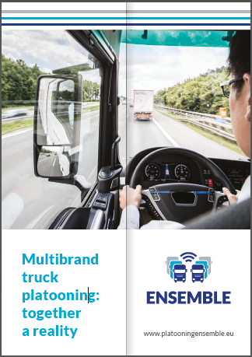
ENSEMBLE VISUAL SOLUTIONS
Infographics for printed material

Slide 9
ENSEMBLE VISUAL SOLUTIONS FOR OEMs
Animated GIFs for on-line content
https://imgflip.com/gif/2ssut6

Slide 10
Upcoming Events
JOIN US!
EUCAD2019
ITS European Congress 2019
SIS submitted from partners
ITS World Congress 2019

Slide 11
Thank you for your attention!

