Slide 1
White Label Truck Platooning specifications

Slide 2
Platooning levels and SAE
Truck platooning, involves driving at short inter-vehicle distances for an extended period.
The platoon as a whole can be seen as a system of interconnected systems with specific requirements.
The driver cannot be held responsible for timely intervention in case of safety-critical events such as hard braking.
Hence, the first three SAE automation levels are not directly applicable for the platooning application.
Need arises to create a different automation level classification for heavy duty vehicles that considers the explained needs of Platooning.
ENSEMBLE will demonstrate Platoon level A and research B and C specifications

Slide 3
Platoon level A
Maximum number of trucks of 7 is considered for platoon level A in ENSEMBLE ​
The time gap distance target between 0.8 and 1.4 s. (as close as possible to reach the benefits),
​Longitudinal automation with fail operation, not lateral automation
This requires new longitudinal functions, e.g. Brake Performance Calculation and safety functions e.g. redundant braking functions, additional sensors
New members of a running platoon can only join from the rear. ​
​The system is in control of the longitudinal functional safety of the vehicle
Interaction with platooning services and infrastructure is technically available
Note: the driver will remain legally responsible at all times such as adverse conditions like bad weather, slopes, etc (it is the drivers decision to activate platooning)

Slide 4
Platoon level A use cases
The main high level use cases of platoon level A are:
Platoon formation
Platoon formation based on generic match making (Orchestrated non real-time)
Platoon formation based on just extended awareness (Orchestrated real-time)
Engaging to platoon
Join from behind by single vehicle
Merge from behind by existing platoon
Platooning
Steady state platooning
Follow to stop (&go)
Emergency braking (caused by AEB system or manual overrule)
Platoon gap adaptation
I2V interaction
Cut-in (long time)
Cut-in (short time) (“Cut-through”)
System status (e.g. packet loss)
Disengage platoon
Leave
Split

Slide 5
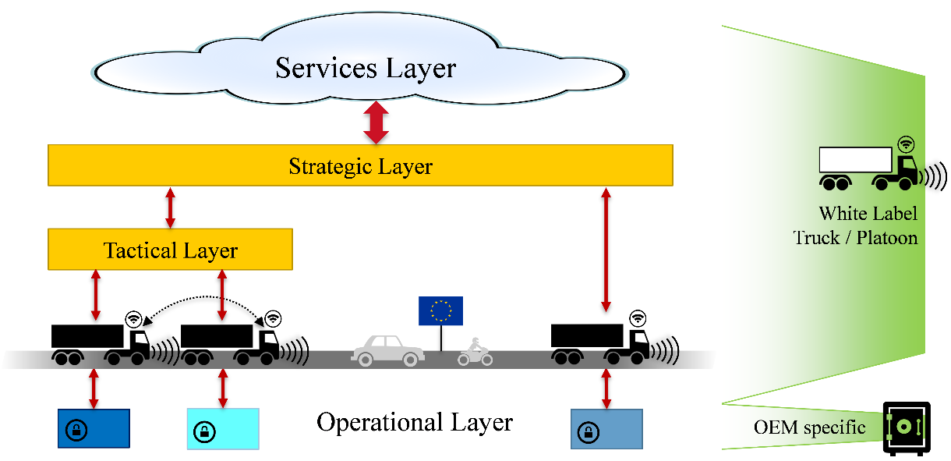
Platooning Layers

Slide 6
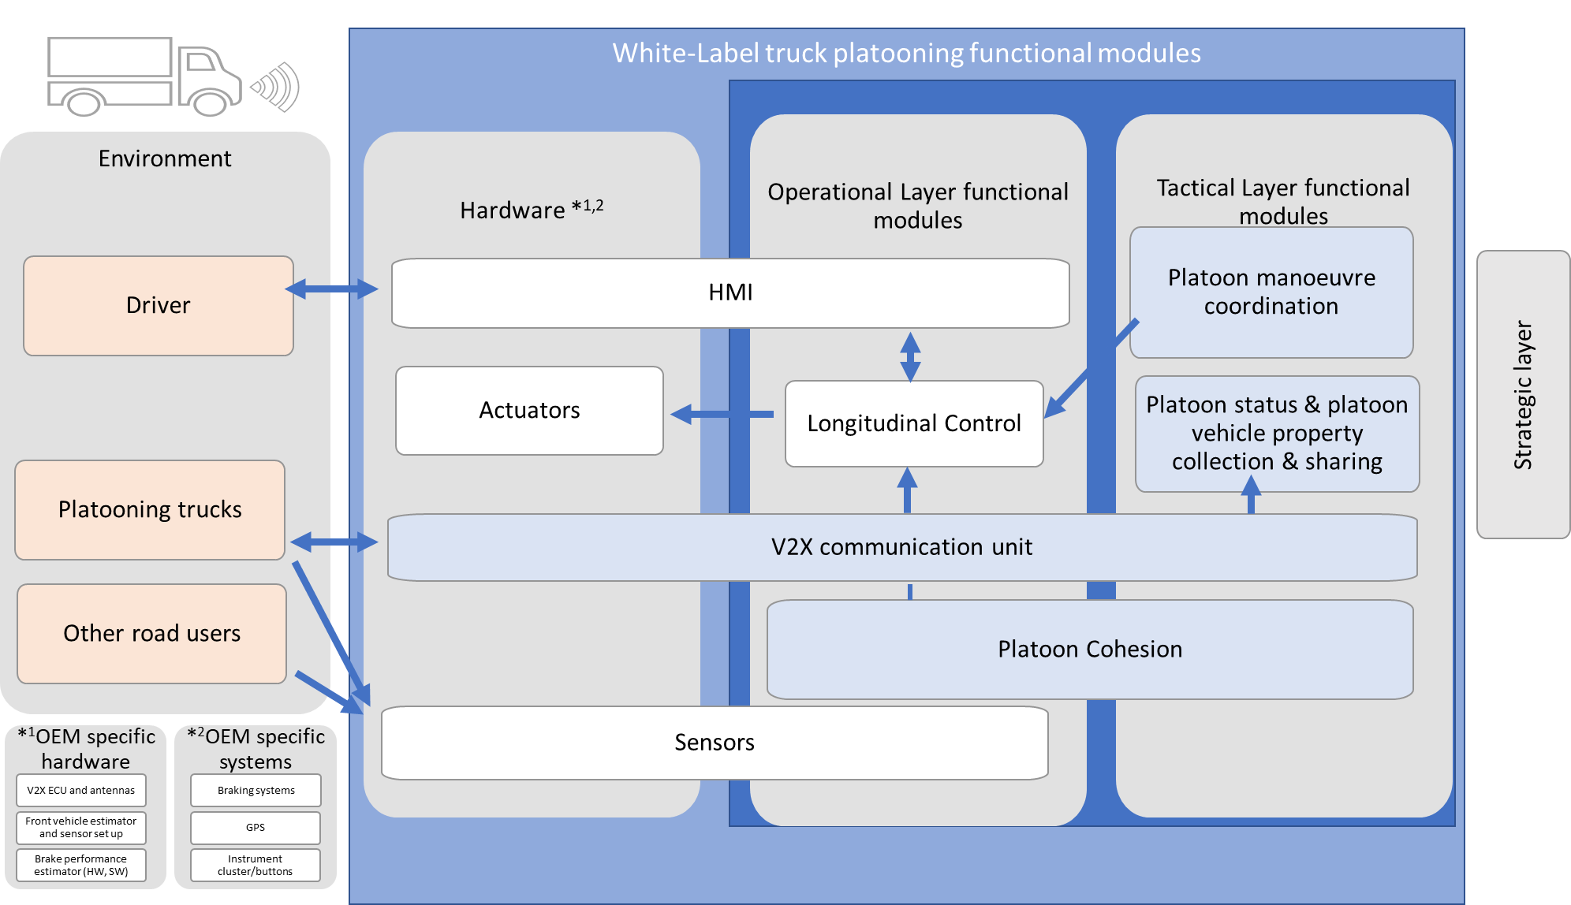
White Label Truck Platooning functional modules

Slide 7
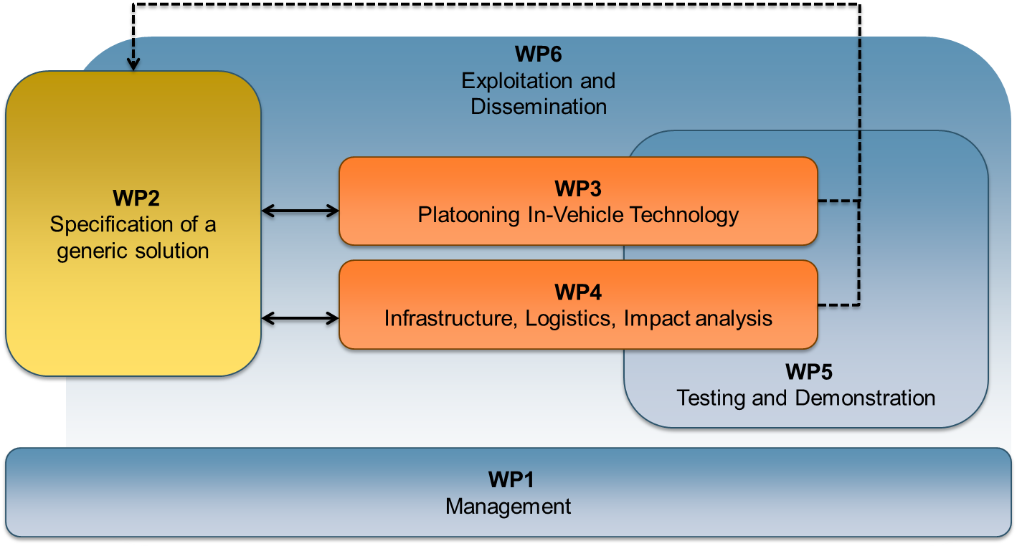
CLEPA ‘s role in the ENSEMBLE project
CLEPA is WP2 leader - WP2 Specification of a generic solution
This WP will define the specification for the whole multi-brand truck platooning concept.
Input for regulation and standardization

